Slide 1


IOD – Mini Project 1
Sebastian Giunta 2022

Slide 2


Overview
Analysis of reported crime incidents in Sydney LGA between Jan 2013 and Mar 2016.
Purpose is to explore this data and achieve a greater understanding.
Source: https://data.nsw.gov.au/data/dataset/non-domestic-assaults-sydney-lga

Slide 3
Dataset
Each record is an offence that has been reported in the NSW Police Force Computerise Operational Policing System (COPS)
Incidents occurred at an outdoor or public place (parks, streets, footpaths) within the Sydney Local Government
23605 Observations

Slide 4
Analysis Focus
What is the most common type of crime?
How do offences change based on day of week?
Which age group and sex commit the greatest number of crimes?
Which is the most common suburb for crime to take place?
What is the most common time for crime to take place?
What is the overall trend in number of crimes in this period? Explore Assaults & Drug Offences, as well as conduct hypothesis test.
What does the heatmap of offences look like?

Slide 5
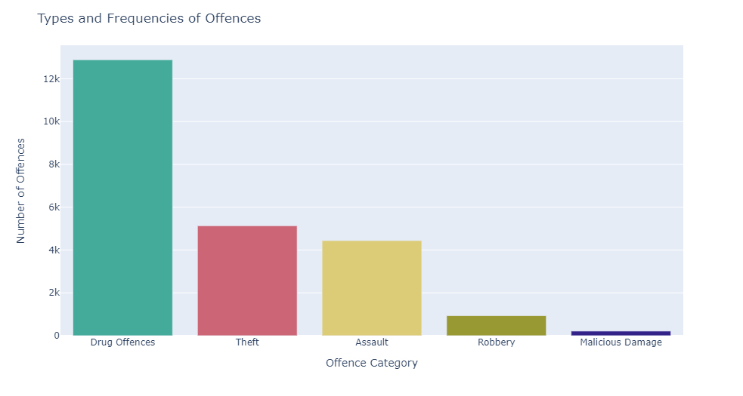
55% of offences committed are Drug Offences

Slide 6
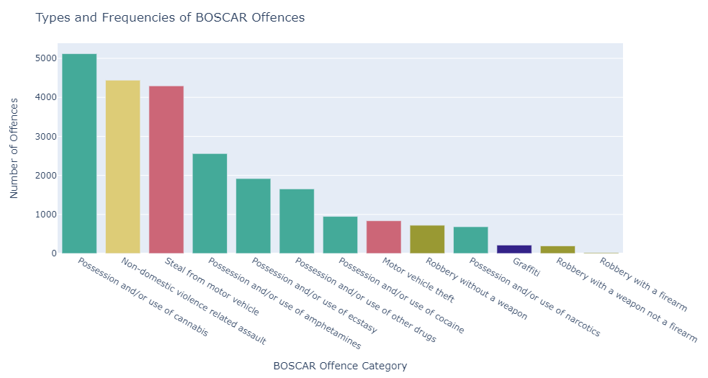
Cannabis, Assault & Stealing from Cars are the most common sub offences

Slide 7
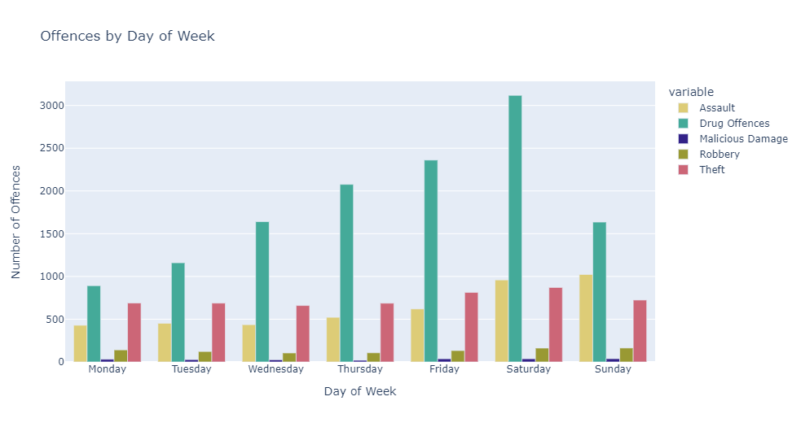
Drug Offences spike on Saturdays

Slide 8
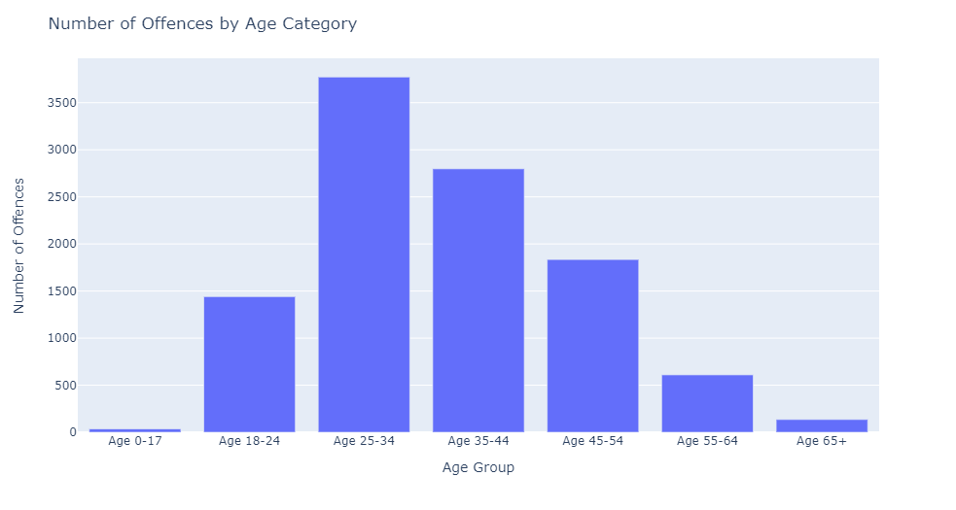
25 to 34 years are the most likely to commit an offence

Slide 9
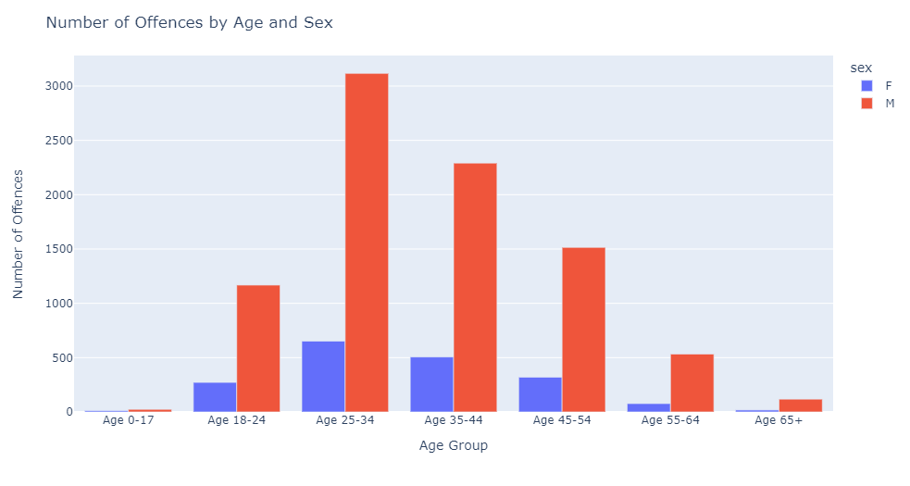
Males commit on average 5-6x more offences than Females

Slide 10
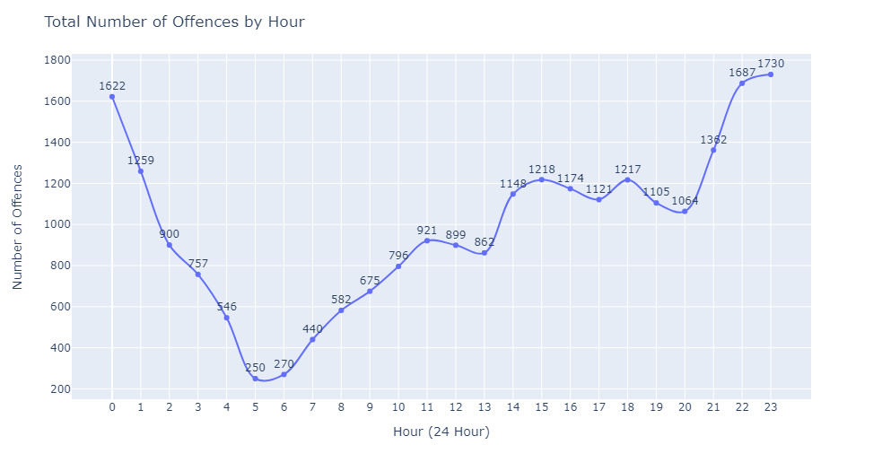
Offences are most likely to be committed between 10pm – 1am

Slide 11
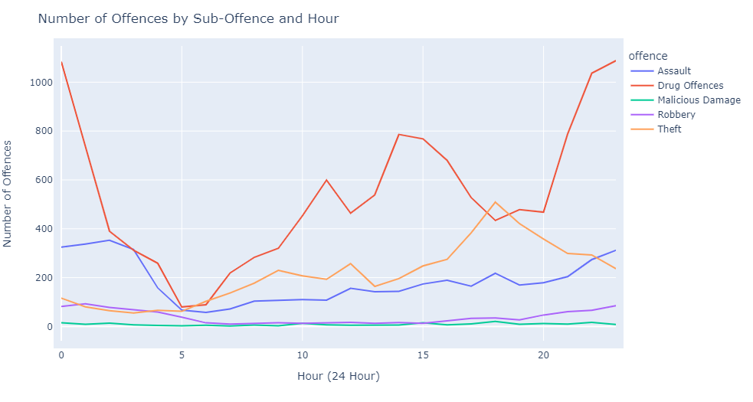
Assaults are most common between 11pm-3am

Slide 12
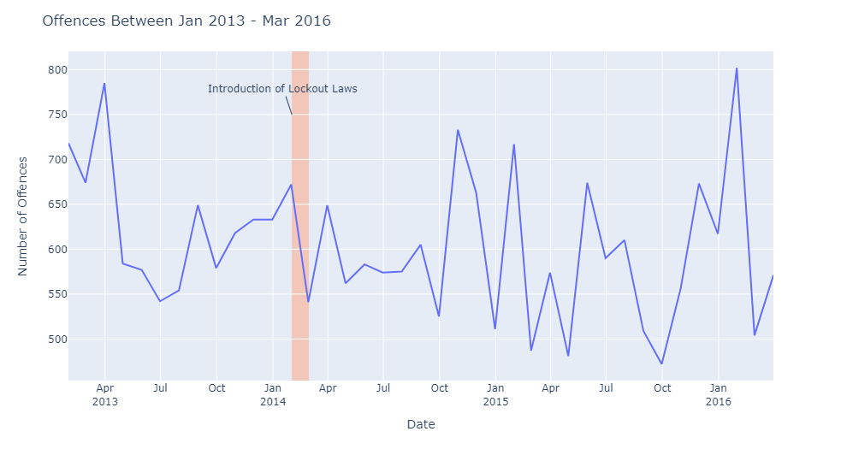
Offences can vary greatly month to month

Slide 13
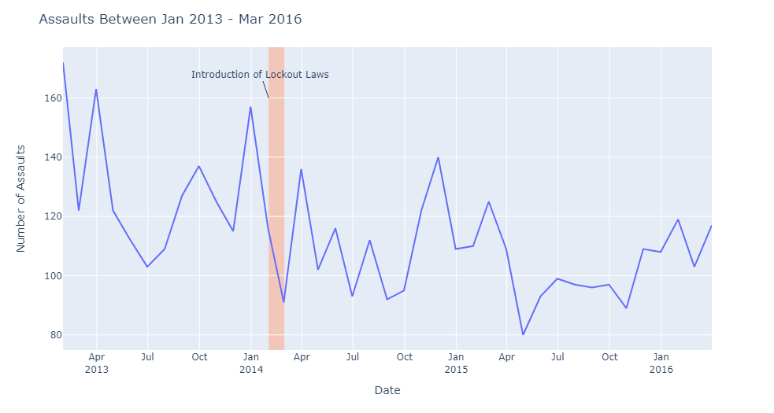
Introduction of the lockout laws appears to have decreased overall number of assaults

Slide 14
Hypothesis Test Null: The lockout laws had no impact on the number of assaults committed Alternative: The lockout laws did have an impact on the number of assaults committed
 | Pre Lockout Laws (Mean) | Post Lockout Laws (Mean) | P-Value
T-test | 129 | 111 | 0.024

Slide 15
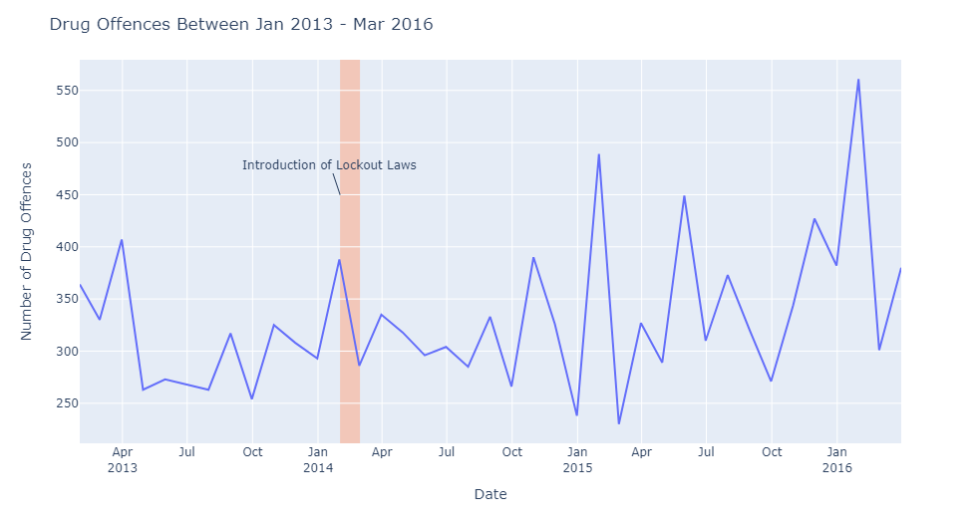
Drug offences appear to have increased after the introduction of the lockout laws

Slide 16
Hypothesis Test Null: The lockout laws had no impact on the number of drug offences committed Alternative: The lockout laws did have an impact on the number of drug offences committed
 | Pre Lockout Laws (Mean) | Post Lockout Laws (Mean) | P-Value
T-test | 312 | 315 | 0.888

Slide 17
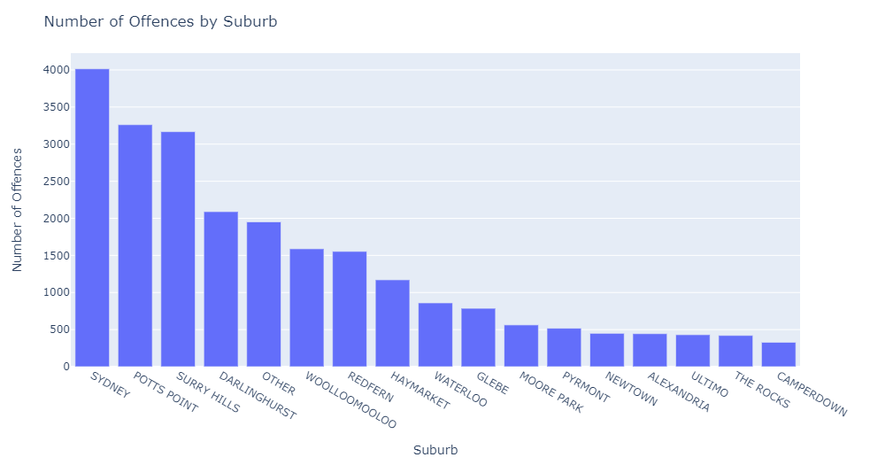
Sydney CBD and Inner Suburbs have the highest number of offences

Slide 18
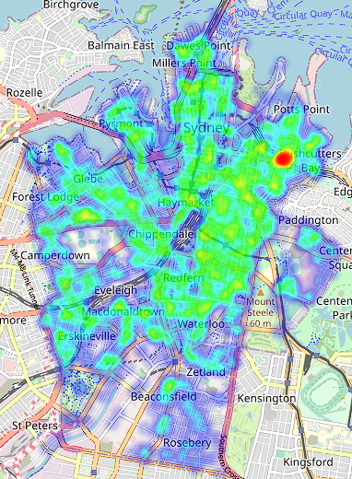
Kings Cross has a much larger density of offences, compared to surrounding areas

Slide 19
Conclusions
Males aged 25-34 are the most likely to commit a crime in public places in the Sydney LGA
Most crimes are committed between 8pm-3am
The lockout laws had an impact on reducing the number of assaults in this area
Total number of offences trend is relatively flat, further research would be required to better understand how to reduce this trend.

